Slide 1

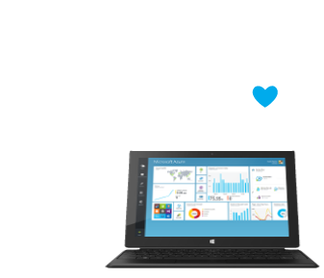
Introduction to Azure
Microsoft's Application Platform for the Public Cloud
Web Services and Cloud
Telerik Software Academy
http://academy.telerik.com

Slide 2
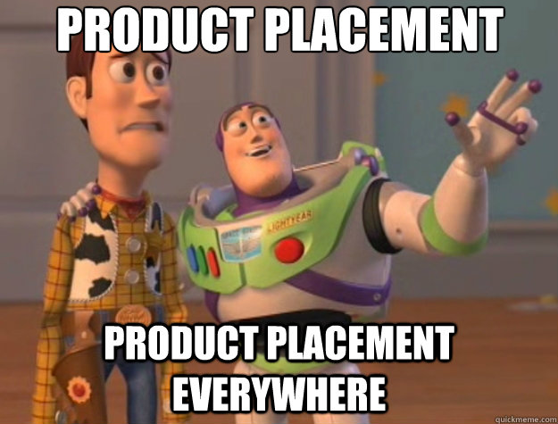

Slide 3
Table of Contents
What is Microsoft Azure?
Compute Services and Virtual Machines
Demo: Windows Server and Ubuntu
Demo: RemoteApp
Data and Storage
Web and Mobile
Demo: Deploying ASP.NET MVC and Web API
Demo: Continuous Deployment
Internet of Things, Big Data, Machine Learning
Demo: Azure Machine Learning
Other Services (Networking, CDN, etc.)
Popular Cloud Architecture

Slide 4
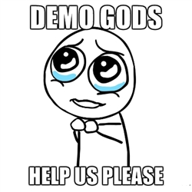

Slide 5
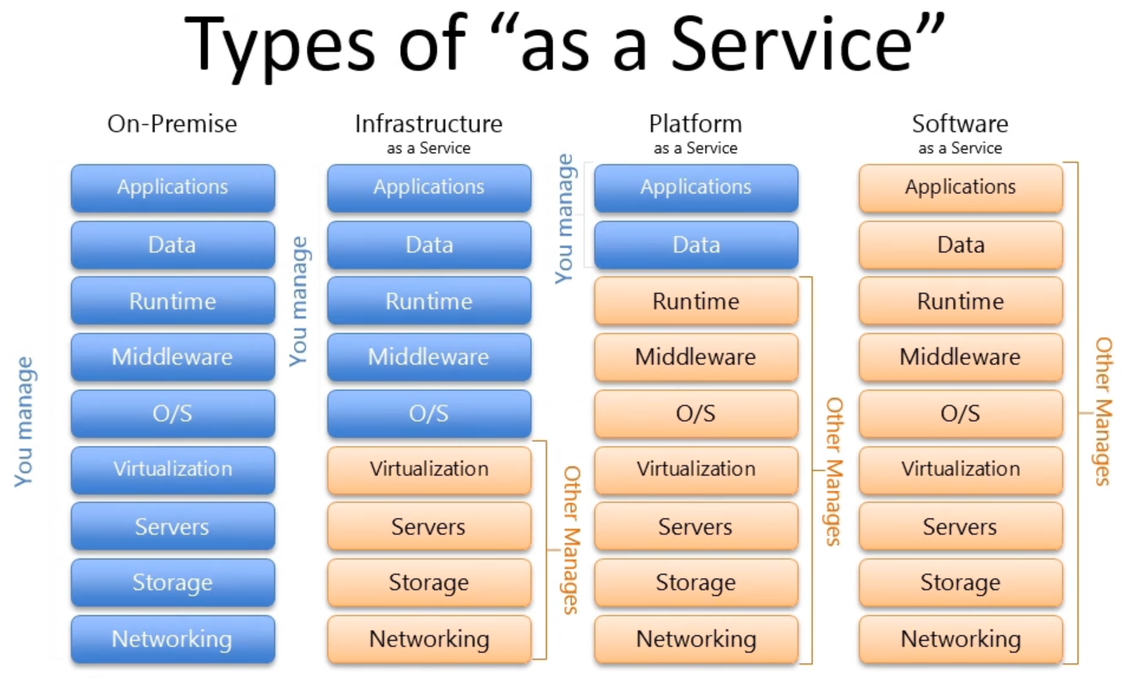
Cloud Computing
A virtualized computing platform that provides infinite resources for running your applications
Leverages economies of scale to save you money (pay for what you use)

Slide 6
What is Microsoft Azure?
Microsoft Azure is a cloud computing platform and infrastructure created by Microsoft
Commercial 1, Commercial 2, Commercial 3
It is provided in Microsoft datacenters located around the world (US, Europe, Asia, Australia)
https://youtube.com/watch?v=0uRR72b_qvc
It provides a range of services that developers and operations people can use, including:
Running and connecting applications
Storing, managing and analyzing data
Networking, media (CDN), IoT, security and more

Slide 7
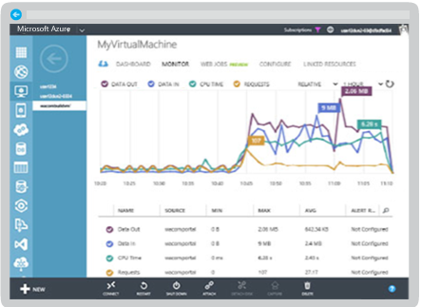
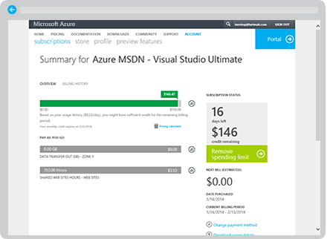
The Components of Azure
Azure has a web interface called the Management Portal that allows you to access and administer most, but not all Azure features
Usage and billing track your Azure usage and view your bill. Azure charges only what you use

Slide 8
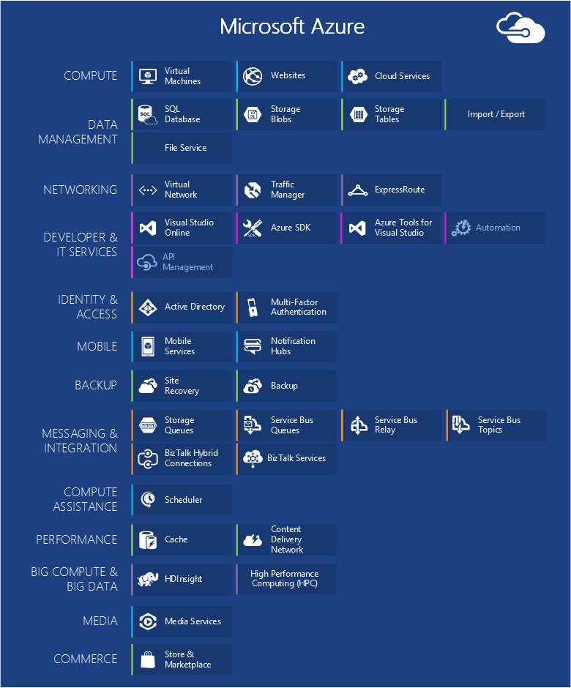
The Components of Azure (2)
Virtual Machines
Web Applications
Cloud Services
Data Management
Networking
Developer Services
Identity and Access
Mobile Services
Back-up
Azure Marketplace
Integration with VS

Slide 9
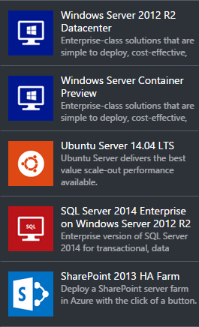
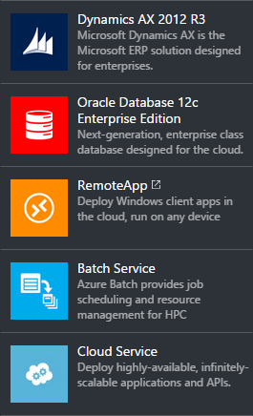
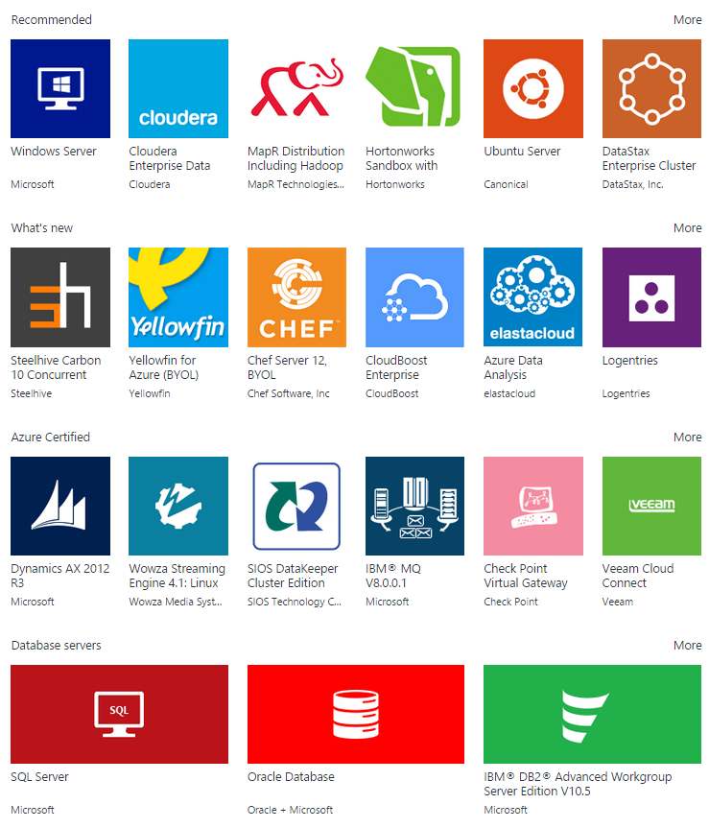
Computing
Computing cloud solutions provided by Azure:

Slide 10
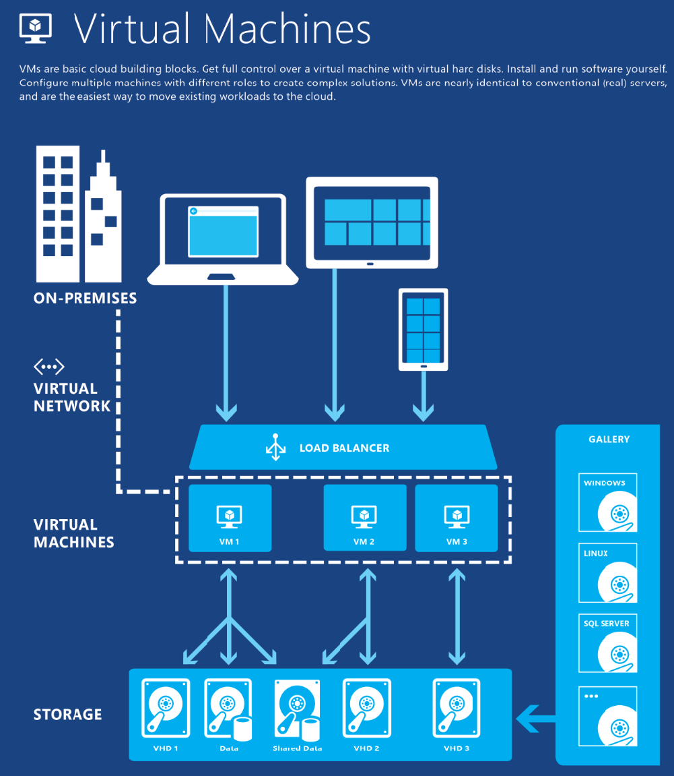
Azure Virtual Machines
Infrastructure as a Service
Windows and Linux VMs
Virtual Machine Scenarios
Development / Test
Move/Run Applications in Azure (Lift-and-shift)
Extend your Datacenter
Commercial video
Built-in Virtual Networking, Load Balancing
Scale from 1 to 1000s of VM Instances
Great choice of configurations and per-minute billing

Slide 11
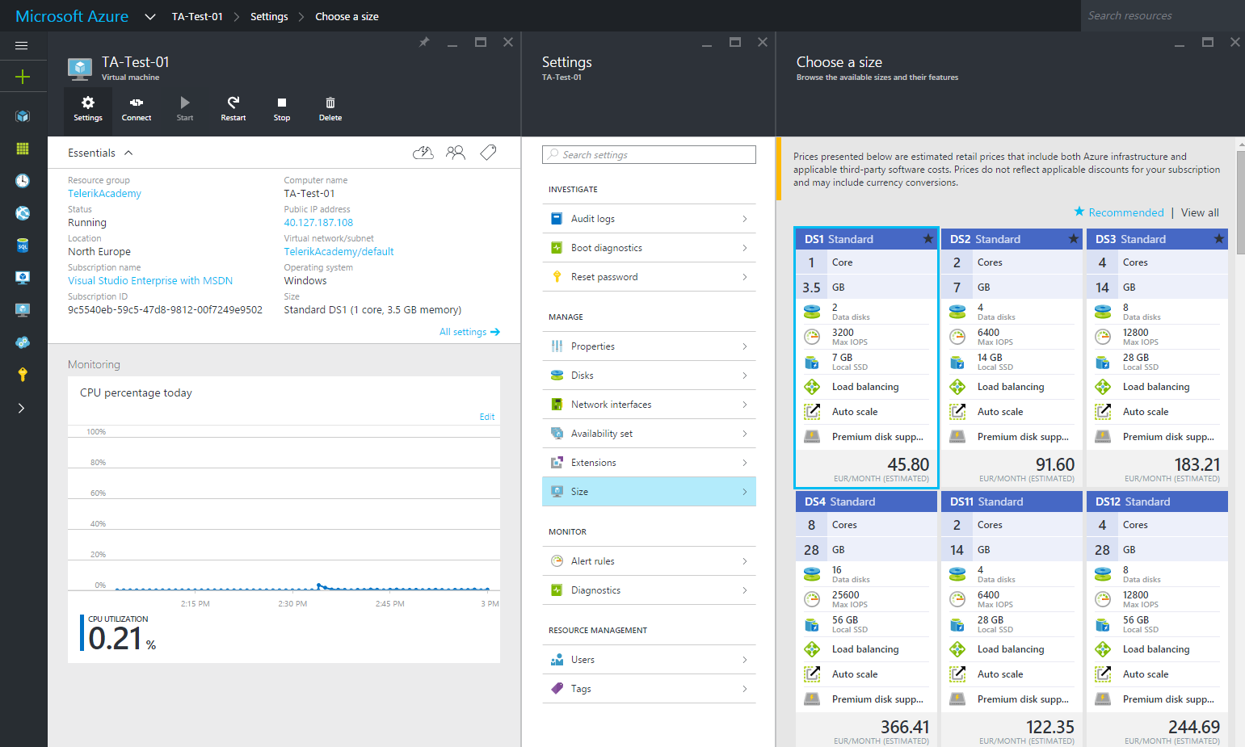
Demo: Windows Server and Ubuntu
Create Windows Server (and Ubuntu) VM
Connect using Remote Desktop / SSH
Manage the Virtual Machines
Upgrade Resources (CPU and RAM)

Slide 12
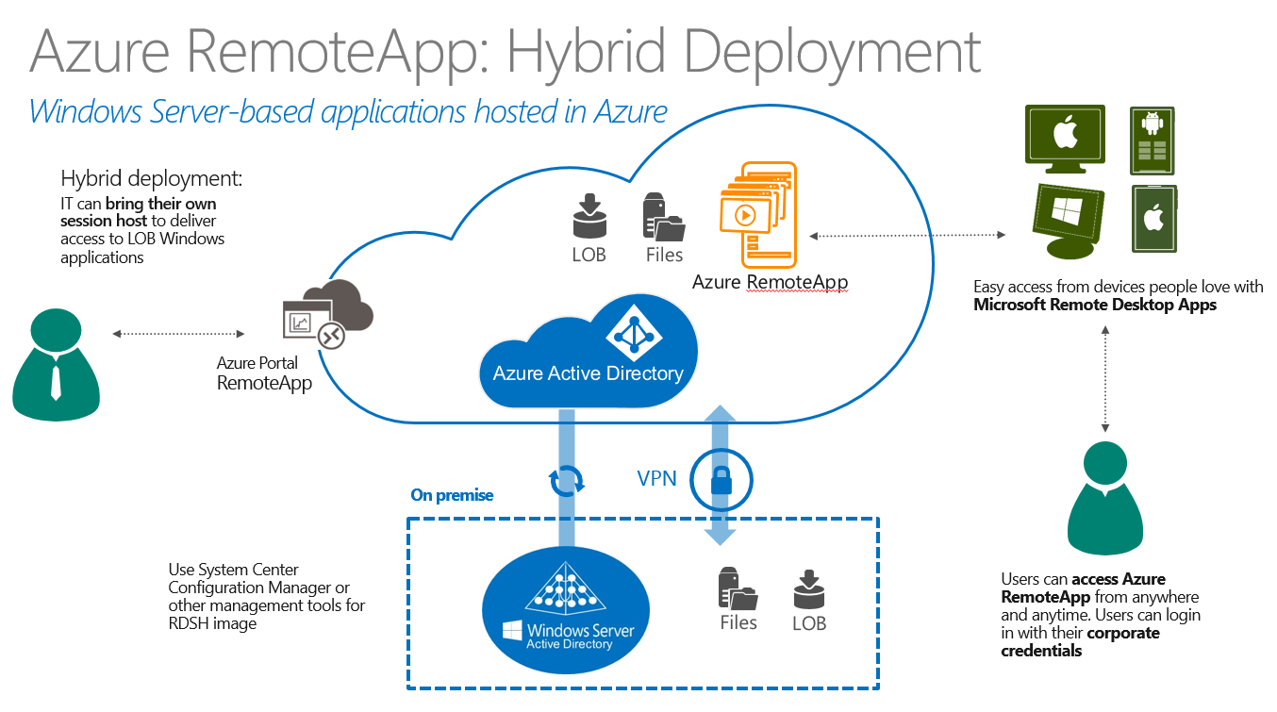
Demo: RemoteApp
https://youtube.com/watch?v=DSuCqmWlr0s
Create RemoteApp from Office Template
Install Azure RemoteApp Client
Connect and Use the Remote Applications

Slide 13
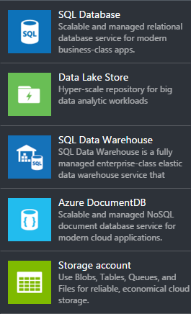
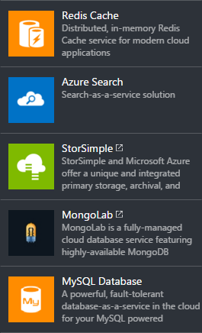
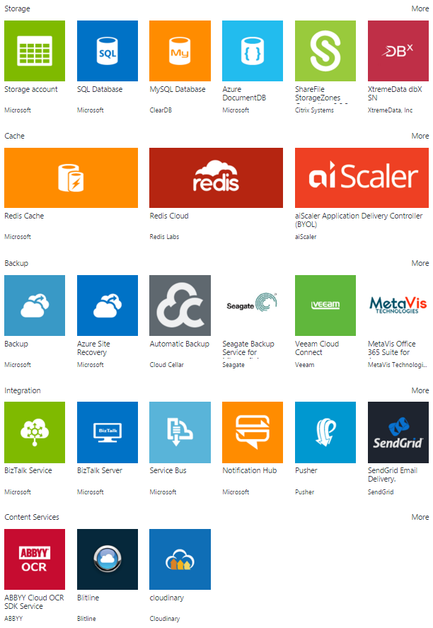
Data + Storage
Applications need data, and different kinds of applications need different kinds of data.

Slide 14
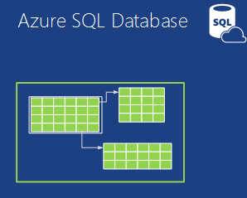
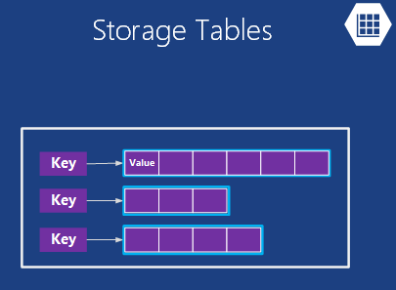
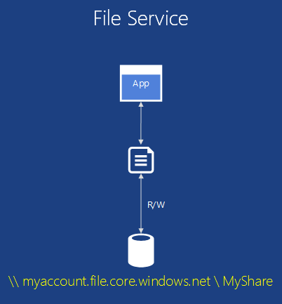
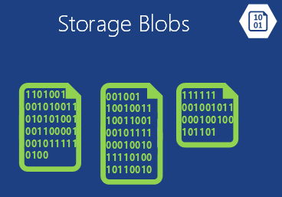
Types of Storage in Azure

Slide 15
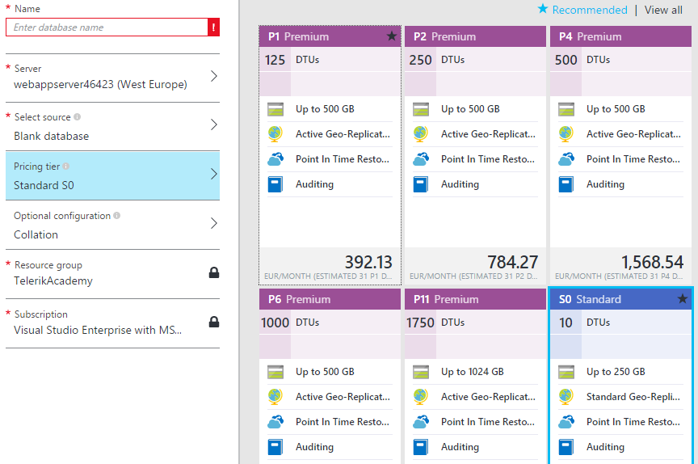
Demo: Create SQL Database
https://youtube.com/watch?v=kukyVj9rQ1Y
https://youtube.com/watch?v=Nn4_EdyN6FM
https://youtube.com/watch?v=FWGtgpzjAPM

Slide 16
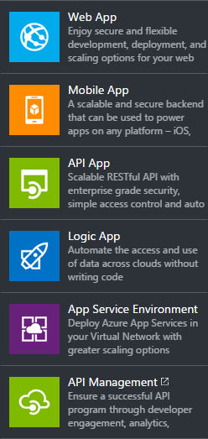
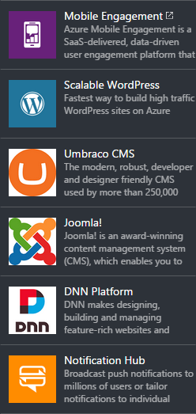
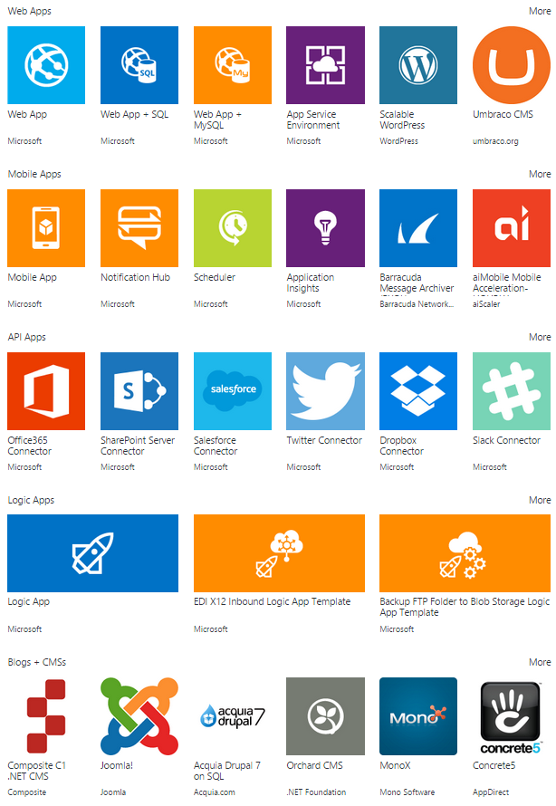
Web + Mobile
Web and Mobile Services by Microsoft Azure

Slide 17
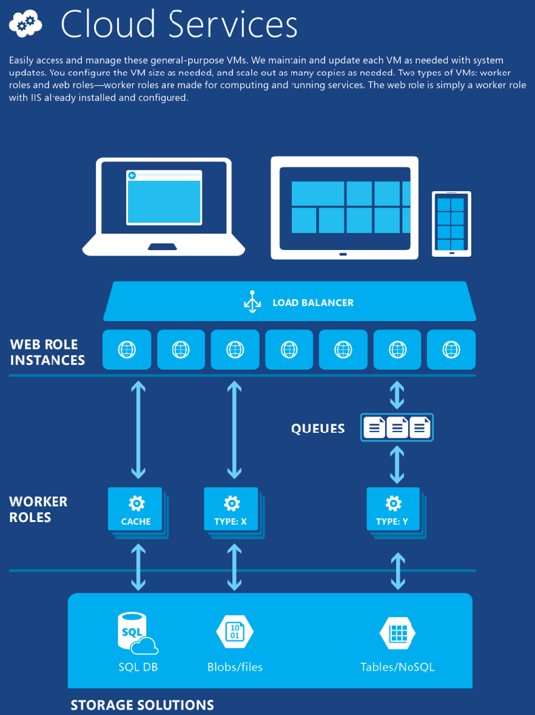
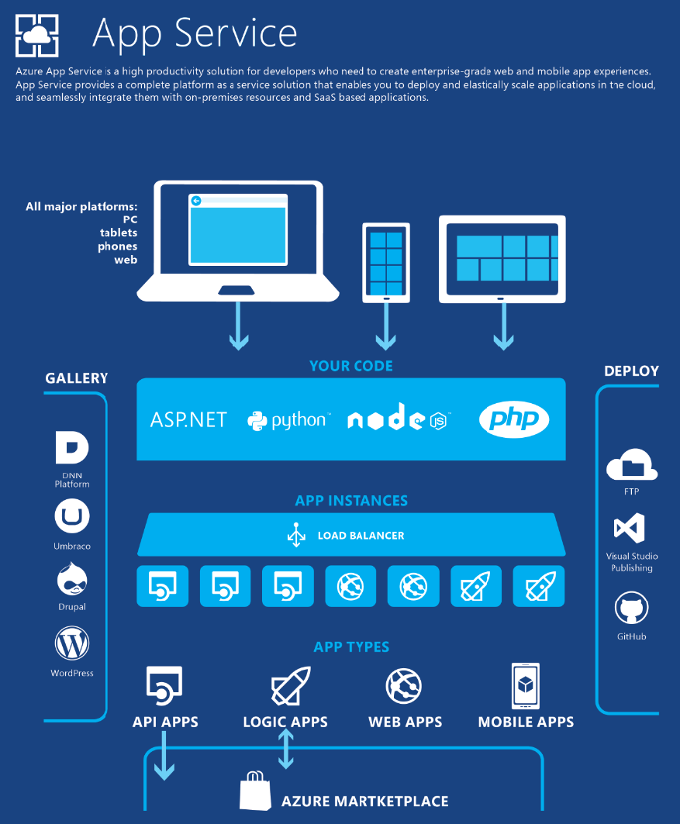

Slide 18
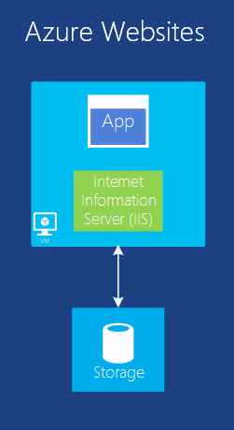
Web Applications
One of the most common things to do in the cloud is to run web apps
VM can do the work but it leaves you with the administering
This compute model offers a managed web environment
Easy deploying with Visual Studio and Continuous Deployment
Management Portal and API
Scaling and Load Balancing
Supports .NET, PHP, Node.js, Java and Python along with SQL Database and MySQL

Slide 19
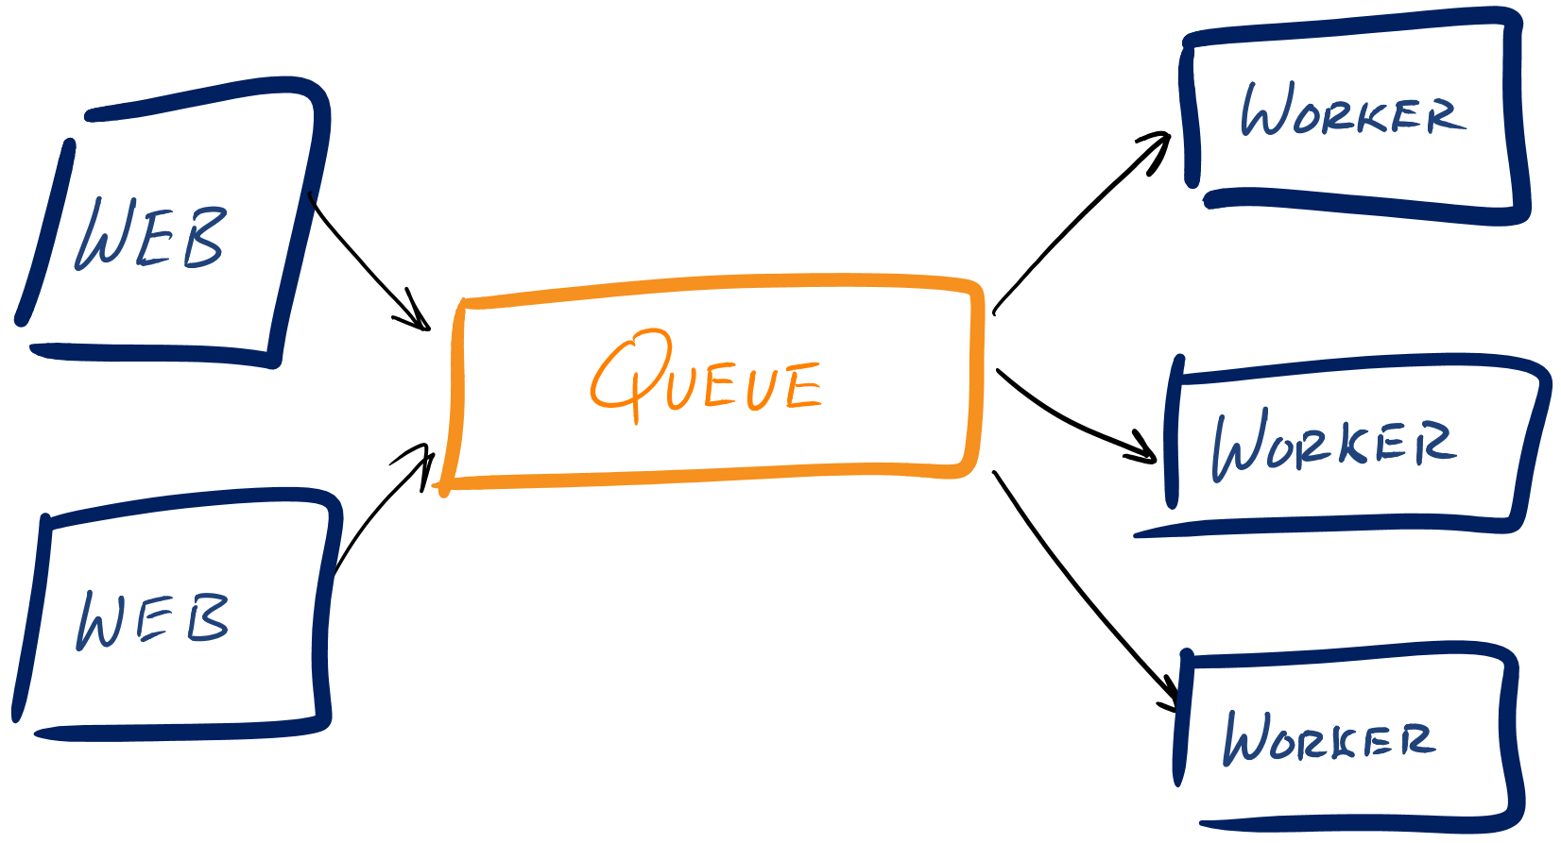
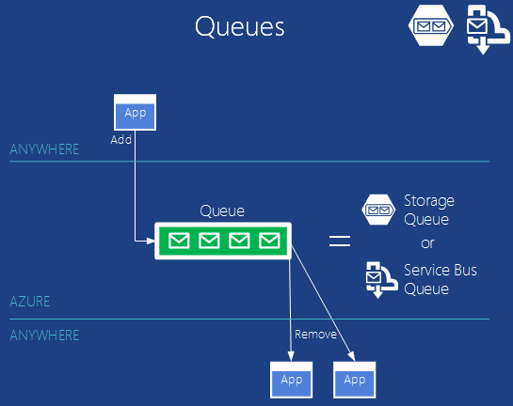
Popular Cloud Architecture
A Web Role is an Azure VM that is pre-configured as a web server (running ASP.NET MVC for example)
Worker Roles run alongside your Web Roles and are responsible for performing computing functions to support your application

Slide 20
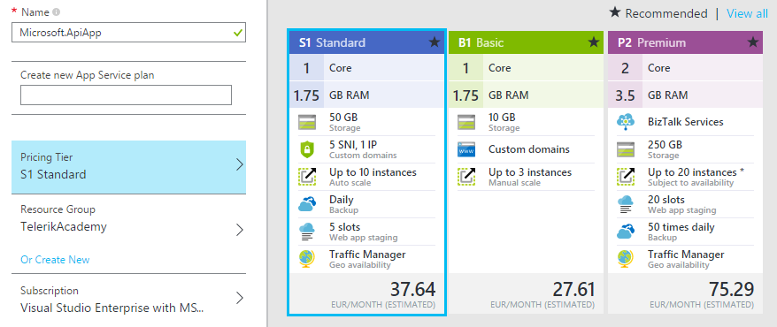
Demo: ASP.NET Web API and MVC in Azure
Create simple ASP.NET WebAPI / MVC application
Attach Azure Publish Profile
Deploy the Application
Login/Register

Slide 21
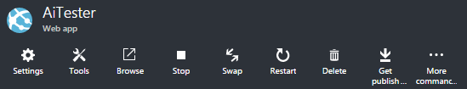
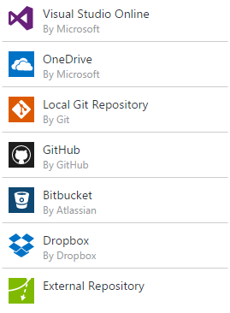

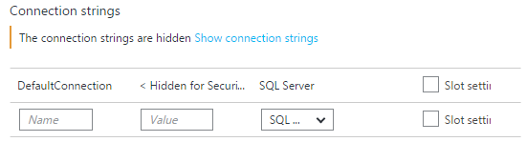
Demo: Continuous Deployment
https://youtube.com/watch?v=3WDe3l1M-3U
Create a new web app
Attach Continuous Deployment
Create a new SQL Server Database
Update DefaultConnection Connection String

Slide 22
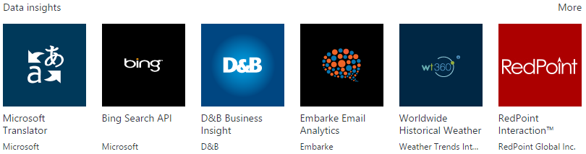
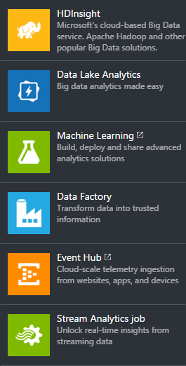
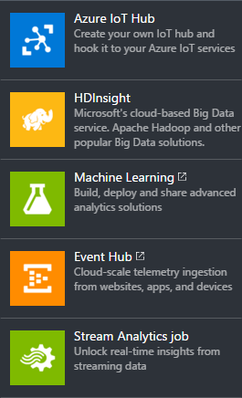
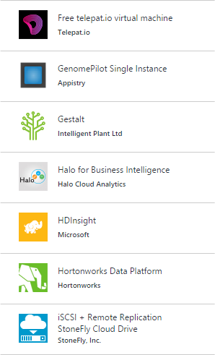
Data, Analytics and IoT

Slide 23
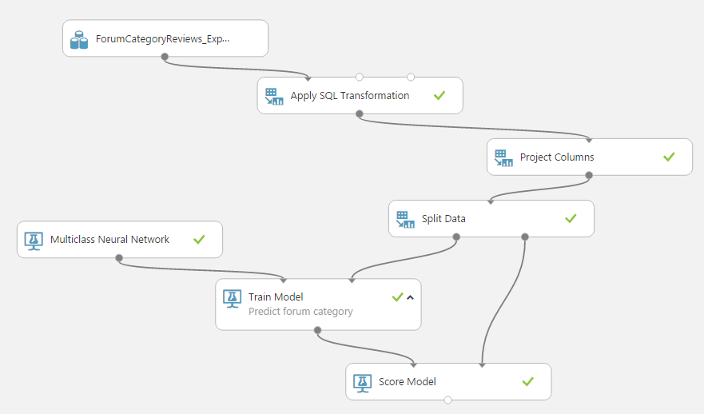
Demo: Azure Machine Learning
https://youtube.com/watch?v=SJtNJepz-pM
https://youtube.com/watch?v=l6dsLyueF0Q
Export/Import Forum Categorization Data
Create and run new Machine Learning Workspace
Open Movie Recommendation Model

Slide 24
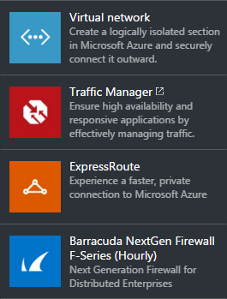
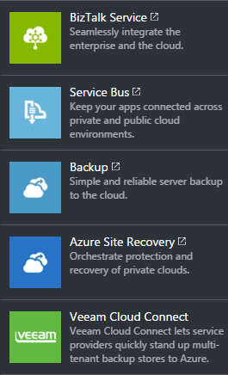
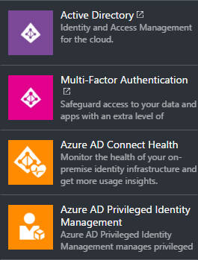
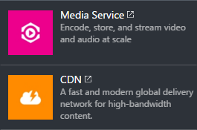
Other Services
Advanced Threat Analytics, IoT Video, IoT Video 2

Slide 25
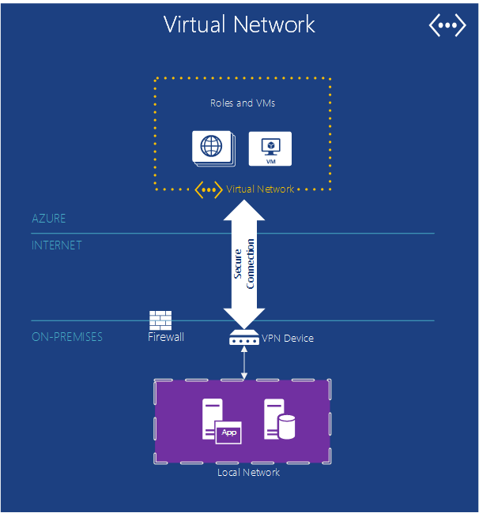
Virtual Network
Features
Isolation
IP addresses
Subnets
External and Internal Load Balancer
Network Security Groups (NSG)
Firewall rules

Slide 26
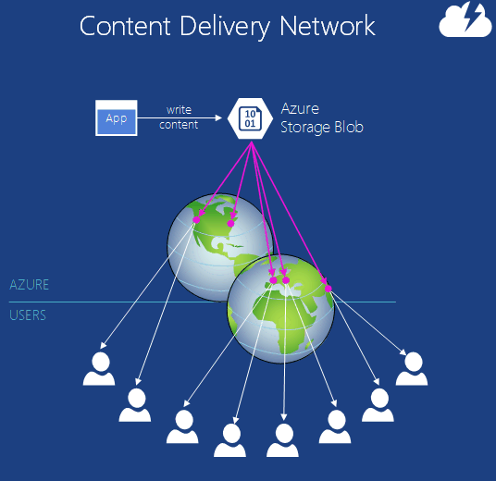
Content Delivery Network
For data that will be accessed around the world
Storing a copy in multiple Azure datacenters
Result is faster access to data
Common usage: JS, CSS, Images, Video files in web applications

Slide 27
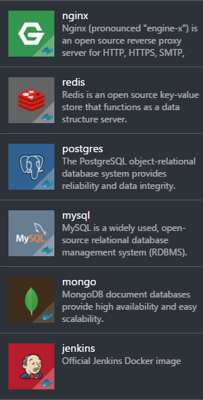
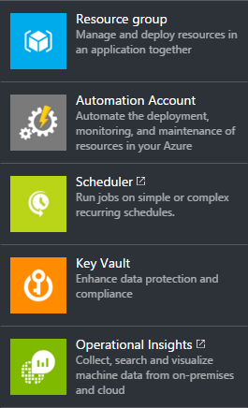
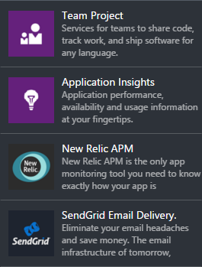
Other Services (2)
Azure Support Video, App Service Video

Slide 28
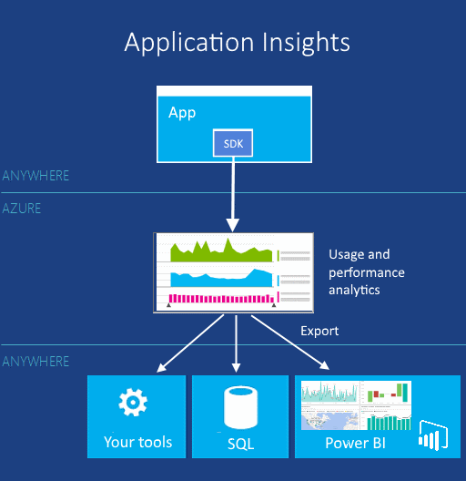
Application Insights
Tells you how app is performing and what users are doing with it
Count of crashes
Slow response
Alerting
Measuring
Web, Desktop, and Mobile apps

Slide 29
Questions?
Introduction to Azure

Slide 30
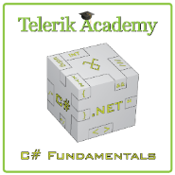



Free Trainings @ Telerik Academy
C# Programming @ Telerik Academy
csharpfundamentals.telerik.com
Telerik Software Academy
academy.telerik.com
Telerik Academy @ Facebook
facebook.com/TelerikAcademy
Telerik Software Academy Forums
forums.academy.telerik.com

